Slide 1

A Project Presentation on “Smartect Security and Automation”
PRESENTED BY | PROJECT GUIDE
Deepak Jangir 1MJ16IS016 | Prof. R.KUMAR
H. S. Rakshak 1MJ16IS021 | AP, Dept of ISE
Krishan Jangir 1MJ16IS029 | MVJCE, Bangalore
Yezdan Rizwan 1MJ16IS063
Approved by AICTE |Affiliated to VTU | Recognized by UGC with 2(f) & 12(B) status |Accredited by NBA and NAAC

Slide 2
Agenda
Introduction
Problem Statement
Proposed Solution
Literature Survey
Hardware & Software Requirement
System Design
System Implementation
System Testing & Validation
Conclusion & Futures Scope
References
Paper Publication Details
Approved by AICTE |Affiliated to VTU | Recognized by UGC with 2(f) & 12(B) status |Accredited by NBA and NAAC

Slide 3

Introduction
Approved by AICTE |Affiliated to VTU | Recognized by UGC with 2(f) & 12(B) status |Accredited by NBA and NAAC

Slide 4
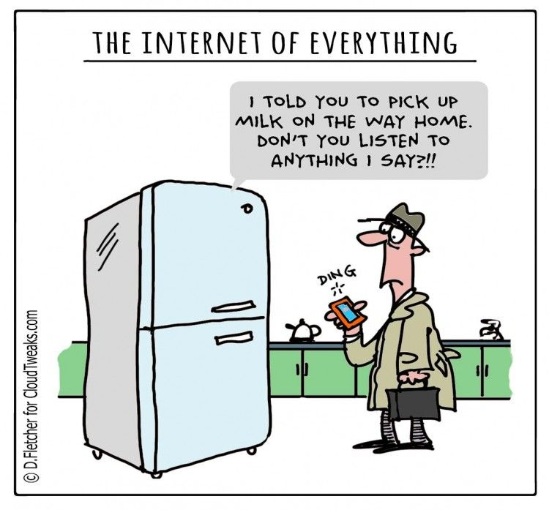
Introduction
Approved by AICTE |Affiliated to VTU | Recognized by UGC with 2(f) & 12(B) status |Accredited by NBA and NAAC

Slide 5

Problem Statement
The world around us is undergoing a lot of unpredictable changes.
Most of the challenges faced, lack the required
“SMART”
to be tackled effectively.
Approved by AICTE |Affiliated to VTU | Recognized by UGC with 2(f) & 12(B) status |Accredited by NBA and NAAC

Slide 6
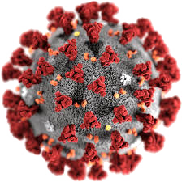
Problem Statement
1.The Global Pandemic – A grim situation for all.
Locked out from your near and dear ones ?
Tough to maintain social distancing ?
This situation is not so grim for some “THINGS” maybe ?
Approved by AICTE |Affiliated to VTU | Recognized by UGC with 2(f) & 12(B) status |Accredited by NBA and NAAC

Slide 7

Problem Statement
2.Buildings and Fire hazards – The age old dilemma
You Only Live Once.
Let’s make the most out of Life.
Who let the Smoke out ?
Approved by AICTE |Affiliated to VTU | Recognized by UGC with 2(f) & 12(B) status |Accredited by NBA and NAAC

Slide 8

Problem Statement
3. Intrusion Detection
Thieves are friends of the dark.
What if it was just your pet ?
Trespassing? We don’t do that here !
Approved by AICTE |Affiliated to VTU | Recognized by UGC with 2(f) & 12(B) status |Accredited by NBA and NAAC

Slide 9

Problem Statement
4. Digital Security
Data is one among the most valuable resources today.
Is it secure enough ?
Encryption is the key.
Approved by AICTE |Affiliated to VTU | Recognized by UGC with 2(f) & 12(B) status |Accredited by NBA and NAAC

Slide 10

Problem Statement
5. Access Control
Existing mechanisms are not very secure.
Tampering of devices is always a scare.
It’s time to Face it, head on.
Approved by AICTE |Affiliated to VTU | Recognized by UGC with 2(f) & 12(B) status |Accredited by NBA and NAAC

Slide 11
Guess
Who
Saves
The
Day!

Slide 12
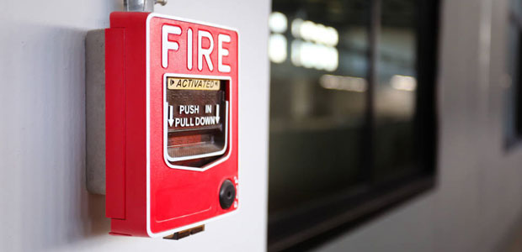
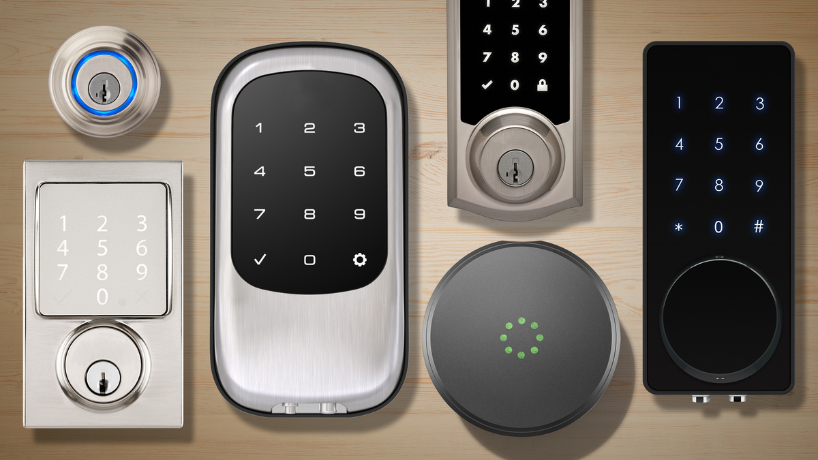
Proposed Solution
Fire Safety System
Equipped with Smoke and Flame sensor
Unlocking of Door and Opening of Windows
Limit the Building’s Electric Supply
This System has a Two-Fold Mechanism
Smart Door Locking System
Face Recognition and RFID
Image Transfer Function
Impact Detection Sensor
Approved by AICTE |Affiliated to VTU | Recognized by UGC with 2(f) & 12(B) status |Accredited by NBA and NAAC

Slide 13
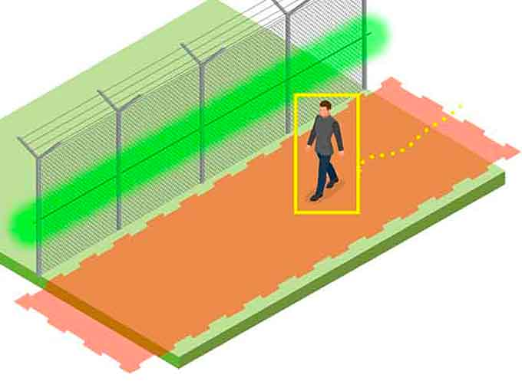

Proposed Solution
Virtual Fencing System
CCTV Camera Equipped with AI
Three Tier Architecture
Laser/PIR Sensor for Detection
Digital Security
Encryption/Decryption
AES Algorithm
Safeguards the Database
Approved by AICTE |Affiliated to VTU | Recognized by UGC with 2(f) & 12(B) status |Accredited by NBA and NAAC

Slide 14

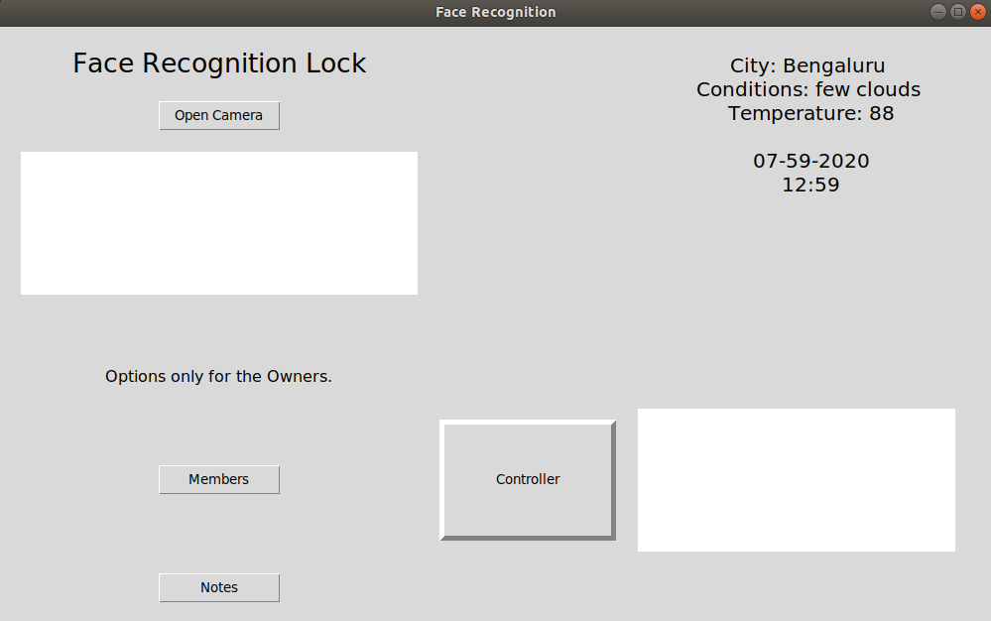
Proposed Solution
Text To Voice Commands
Pyttsx3 Module
“The House Speaks to You”
Graphical User Interface (Application)
Tkinter Module
Touch Access
Remote Assistance
Approved by AICTE |Affiliated to VTU | Recognized by UGC with 2(f) & 12(B) status |Accredited by NBA and NAAC

Slide 15
Literature Survey - I
Survey Title: Smart Door Lock System with Face Recognition Method
Author Name: Sourav Roy, Md Nasir Uddin, Md Zahirul Haque, Md Jahidul Kabir
Publication Details: Nanjing University of Posts and Telecommunications, China. Published in IJCSN Volume 7, Issue 6, December 2018
Features :
Consists of three subsystems: to be specific face recognition, face detection and automated door access control.
An app will be interfaced with the lock system to automate and control every process.
The system can open the door lock in real-time after recognizing a visitor’s image.
Approved by AICTE |Affiliated to VTU | Recognized by UGC with 2(f) & 12(B) status |Accredited by NBA and NAAC

Slide 16
Literature Survey - II
Survey Title: Analysis of Magnitude for Earthquake Detection
Author Name: Narasimha Prasad, L V Shankar Murthy P, Kishor Kumar Reddy C
Publication Details: ICHCI in September 2014, IEEE.
Features :
The earthquake warning alarm system detects the first quivering of a major Earth Quake.
The system uses the MPU-6050 (Accelerometer and Gyroscope) sensor and a detection algorithm to detect the Seismic Waves.
A threshold will be set by analysing the collected data.
If the value returned by the sensor is above the threshold, an alert will be sent to the user notifying him about a possible earthquake.
Approved by AICTE |Affiliated to VTU | Recognized by UGC with 2(f) & 12(B) status |Accredited by NBA and NAAC

Slide 17
Literature Survey - III
Survey Title: Detecting Intrusion in Large Farm Lands & Plantations Using VirtualFences
Author Name: AJAYI Olasupo Opeyemi, OLAIFA Oluwaseun
Publication Details: University of Lagos, Nigeria, 2016.
Features :
A perimeter wall is built using multiple pairs of infrared sensors around an area of interest.
Each pair consists of a transmitter and a receiver connected wirelessly to a centrally monitored control station.
An alert signal is triggered Once the infrared link between the transmitter and receiver is broken by an intruder.
Approved by AICTE |Affiliated to VTU | Recognized by UGC with 2(f) & 12(B) status |Accredited by NBA and NAAC

Slide 18
Literature Survey - IV
Survey Title: Fire Alarm System Using IoT
Author Name: R. Angeline, Adithya S, Abishek Narayanan
Publication Details: IJITEE, Volume 8, Issue 6S3, April 2019
Features :
Includes a flame sensor, PIR sensor, as well as a gas sensor.
Also includes CCTV to monitor most prone areas.
Does not provide any mechanism to tackle a fire.
Approved by AICTE |Affiliated to VTU | Recognized by UGC with 2(f) & 12(B) status |Accredited by NBA and NAAC

Slide 19
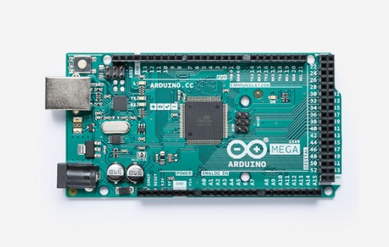
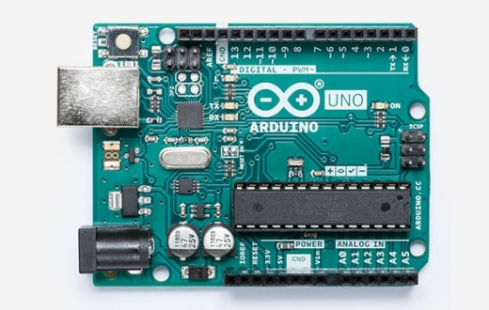
Hardware and Software Requirements
Arduino Mega 2560 REV3 & Arduino Uno REV3
Microcontroller
Brain of the Project
Approved by AICTE |Affiliated to VTU | Recognized by UGC with 2(f) & 12(B) status |Accredited by NBA and NAAC

Slide 20
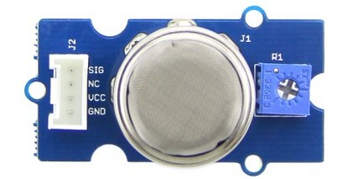
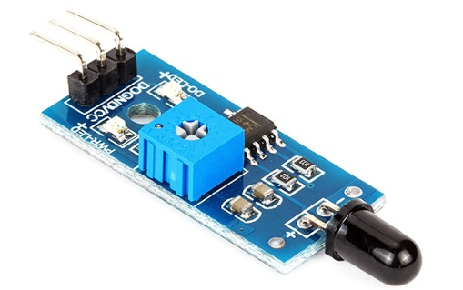
Hardware and Software Requirements
2. MQ2 Gas Sensor
Detecting Gas Leakage
Combustible Gas And Smoke Detection
3. Flame Sensor
Sensitive To Infrared Radiation
Locating The Source Of Fire
Approved by AICTE |Affiliated to VTU | Recognized by UGC with 2(f) & 12(B) status |Accredited by NBA and NAAC

Slide 21
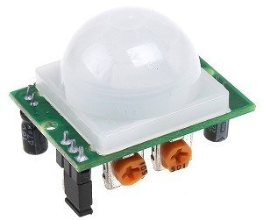
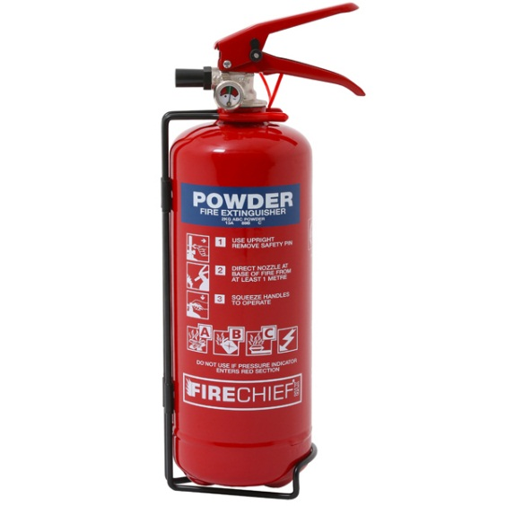
Hardware and Software Requirements
4. PIR Sensor
Passive Infrared Sensor
Sense Motion
Small, Inexpensive, Low-powered & Easy To Use
5. Fire Extinguisher
External Fire Safety System
Approved by AICTE |Affiliated to VTU | Recognized by UGC with 2(f) & 12(B) status |Accredited by NBA and NAAC

Slide 22
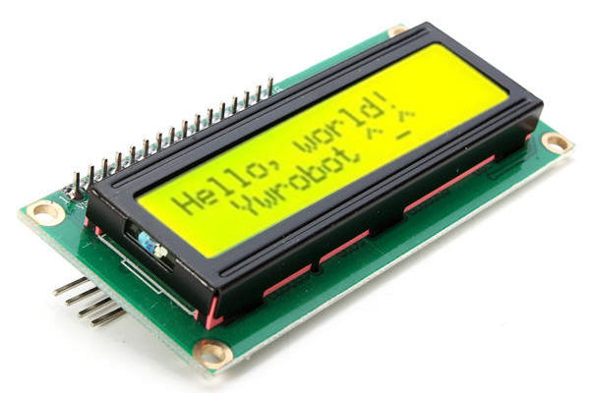
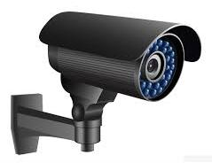
Hardware and Software Requirements
6. 16x2 LCD Display
Liquid Crystal Display
Flat-panel Screen
7. CCTV
Closed Circuit Television
Video Surveillance
Approved by AICTE |Affiliated to VTU | Recognized by UGC with 2(f) & 12(B) status |Accredited by NBA and NAAC

Slide 23
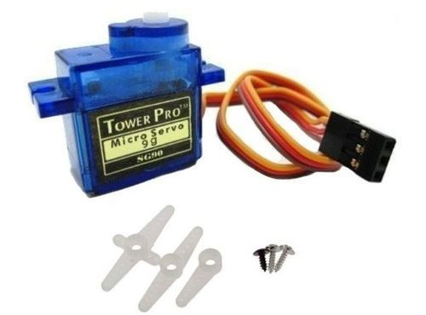
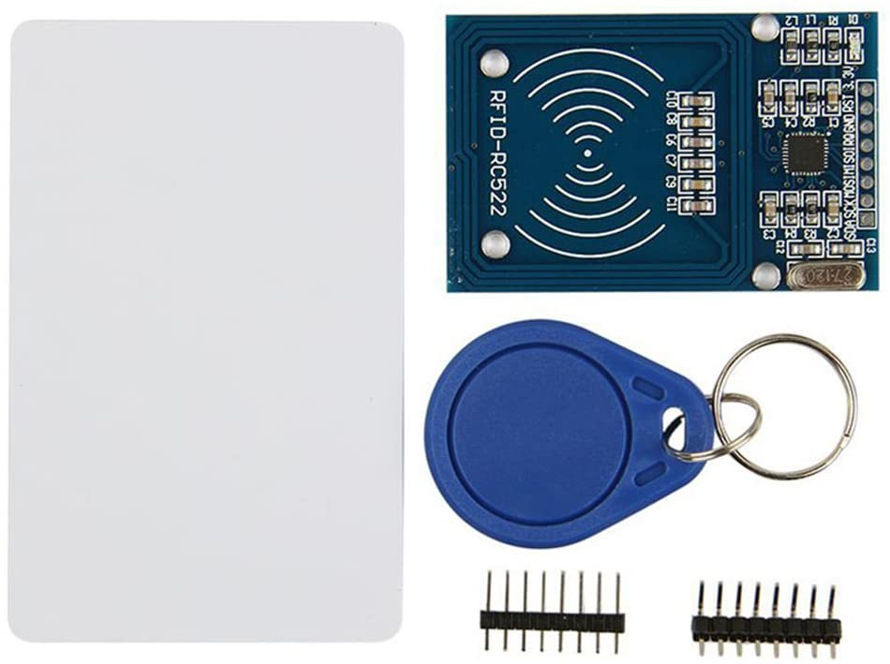
Hardware and Software Requirements
8. SG90 Servo Motor
Precisely Move Or Rotate An Object
Servo Mechanism
9. MFRC-522 RC522 RFID
Radio Frequency Identification (RFID)
Approved by AICTE |Affiliated to VTU | Recognized by UGC with 2(f) & 12(B) status |Accredited by NBA and NAAC

Slide 24

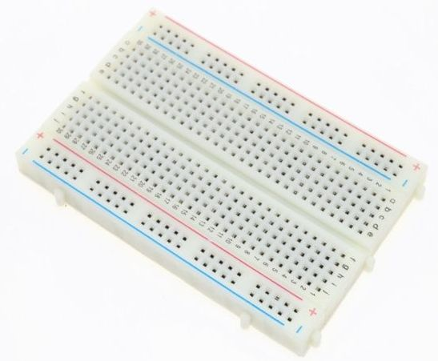
Hardware and Software Requirements
10. LEDs
Light Emitting Diode
11. Breadboard
Rectangular Plastic Board
Approved by AICTE |Affiliated to VTU | Recognized by UGC with 2(f) & 12(B) status |Accredited by NBA and NAAC

Slide 25
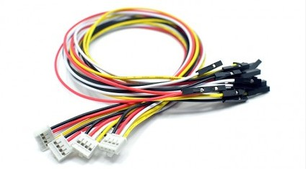
Hardware and Software Requirements
12. Jumper Cables
Used To Connect Two Points Without Soldering Each Other
Used With Breadboards
Approved by AICTE |Affiliated to VTU | Recognized by UGC with 2(f) & 12(B) status |Accredited by NBA and NAAC

Slide 26




Hardware and Software Requirements
Software Requirements
Platform : Ubuntu 18.04 LTS or Windows 7/8/10
Language : Python and C
IDE/tool : Arduino IDE and Visual Studio Code
Approved by AICTE |Affiliated to VTU | Recognized by UGC with 2(f) & 12(B) status |Accredited by NBA and NAAC

Slide 27
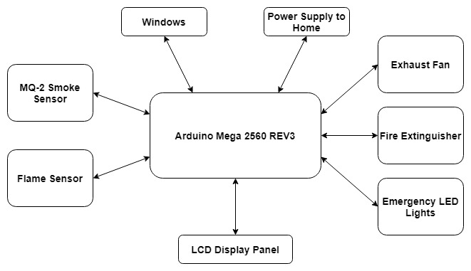
System Design
System Architecture
Module - 1
Approved by AICTE |Affiliated to VTU | Recognized by UGC with 2(f) & 12(B) status |Accredited by NBA and NAAC

Slide 28
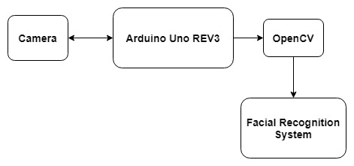
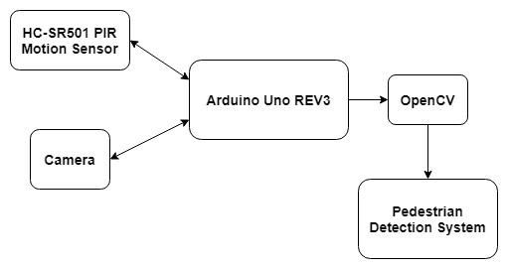
Module - 2
Module - 3
Approved by AICTE |Affiliated to VTU | Recognized by UGC with 2(f) & 12(B) status |Accredited by NBA and NAAC

Slide 29
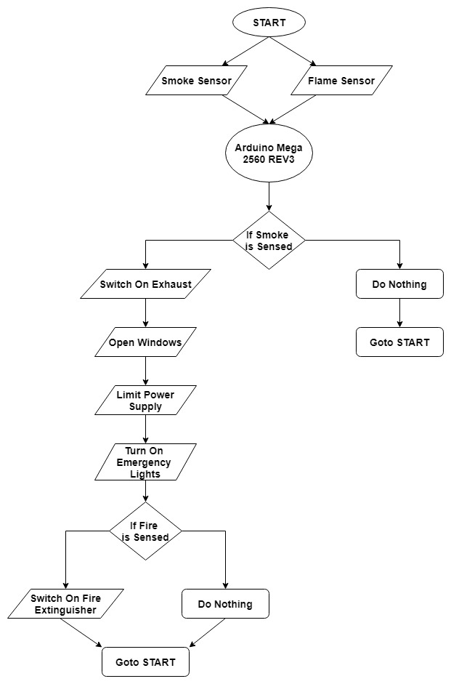
System Flowchart
Approved by AICTE |Affiliated to VTU | Recognized by UGC with 2(f) & 12(B) status |Accredited by NBA and NAAC

Slide 30
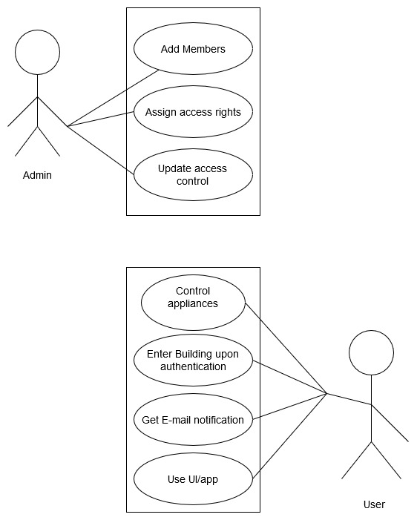
System Design
Use Case Diagram
Approved by AICTE |Affiliated to VTU | Recognized by UGC with 2(f) & 12(B) status |Accredited by NBA and NAAC

Slide 31
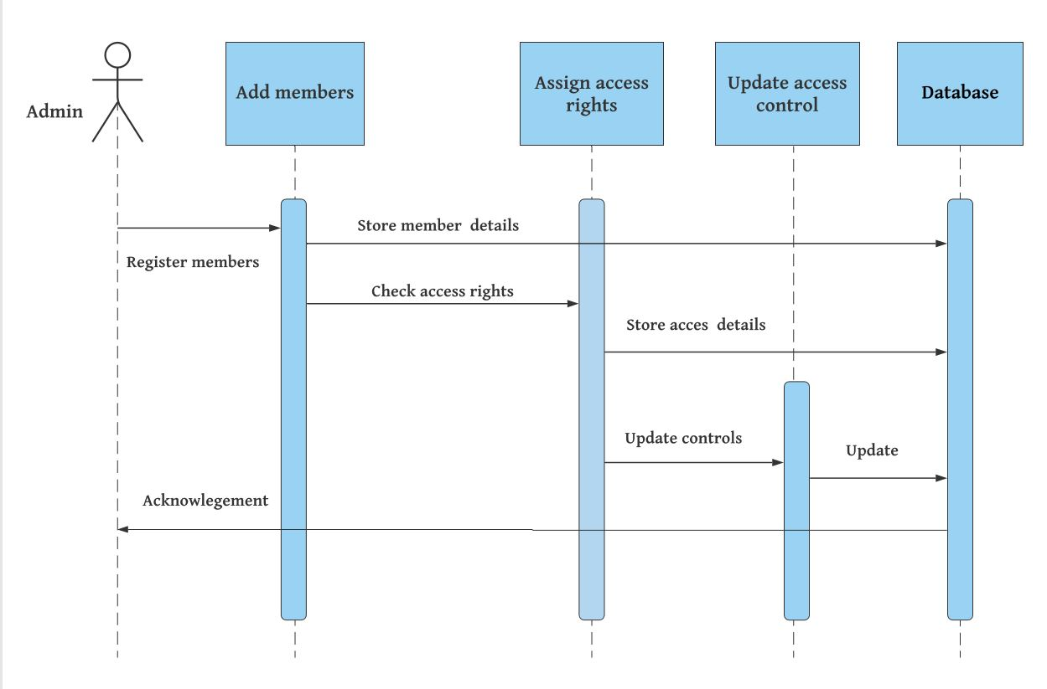
System Design
SEQUENCE DIAGRAM
Sequence Diagram Of Administrator
Approved by AICTE |Affiliated to VTU | Recognized by UGC with 2(f) & 12(B) status |Accredited by NBA and NAAC

Slide 32
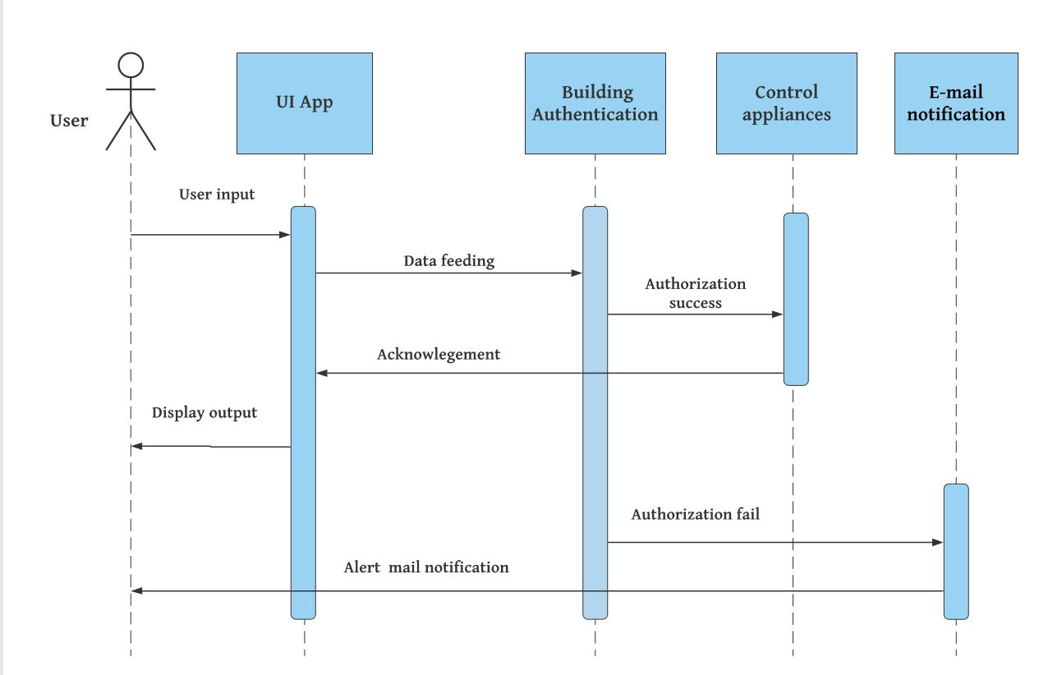
System Design
Sequence Diagram Of User
Approved by AICTE |Affiliated to VTU | Recognized by UGC with 2(f) & 12(B) status |Accredited by NBA and NAAC

Slide 33
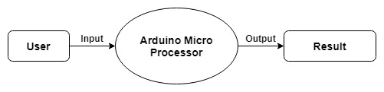
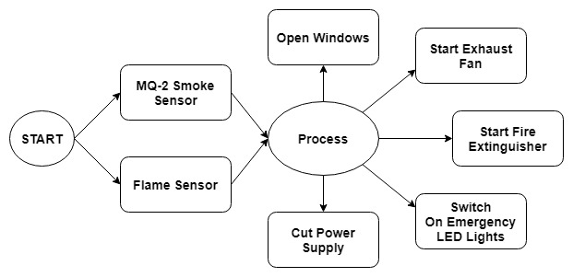
Data Flow Diagram
Level 0 Data Flow Diagram
Level 1 Data Flow Diagram
Approved by AICTE |Affiliated to VTU | Recognized by UGC with 2(f) & 12(B) status |Accredited by NBA and NAAC

Slide 34
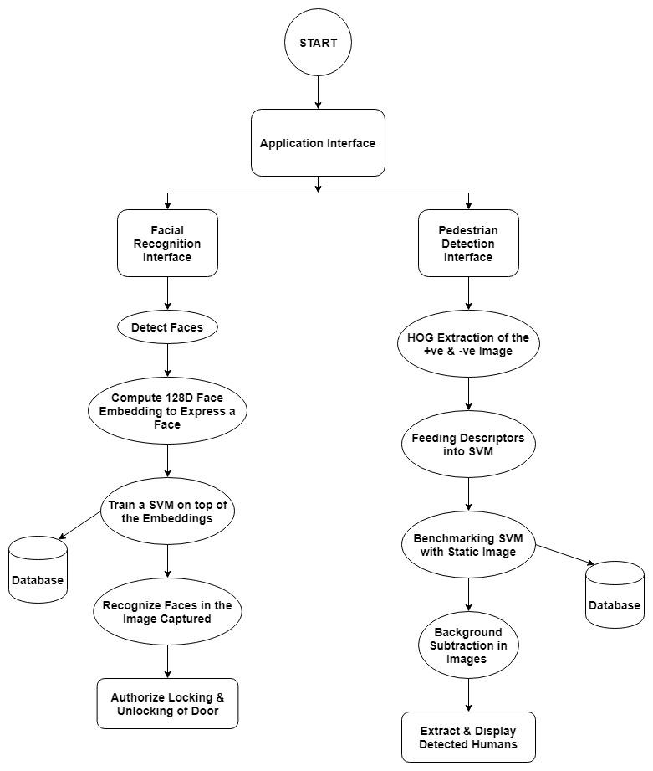
System Design
Level 2 Data Flow Diagram
Approved by AICTE |Affiliated to VTU | Recognized by UGC with 2(f) & 12(B) status |Accredited by NBA and NAAC

Slide 35
System Implementation
“SMARTECT Security and Automation” consist of total six modules:-
Fire Safety
Face Detection
Intrusion Detection
UI and app
Encryption
Text to Voice Module
Approved by AICTE |Affiliated to VTU | Recognized by UGC with 2(f) & 12(B) status |Accredited by NBA and NAAC

Slide 36
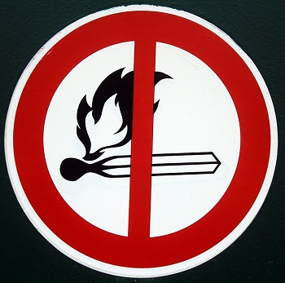
System Implementation
Module Implementation
Fire Safety
The smoke and flame sensors are placed in the room where there is a high chance of fire for example kitchens, laboratories, indoor fireplaces etc.
To prevent false positives we have implemented an image recognition module that detects the incoming video and converts it to frames.
It then converts the video into HSV color space which is closer to how humans perceive color and then takes it takes a upper and lower range of orange color and shows pixels detected in that range.
Approved by AICTE |Affiliated to VTU | Recognized by UGC with 2(f) & 12(B) status |Accredited by NBA and NAAC

Slide 37
System Implementation
Module Implementation
1. Fire Safety
The Arduino Mega 2560 REV3 is programmed to limit the power supply of the building to prevent further damages.
The windows of the building are automatically opened to remove excess smoke.
An exhaust fan is also switched on to remove excess smoke from the building.
Approved by AICTE |Affiliated to VTU | Recognized by UGC with 2(f) & 12(B) status |Accredited by NBA and NAAC

Slide 38
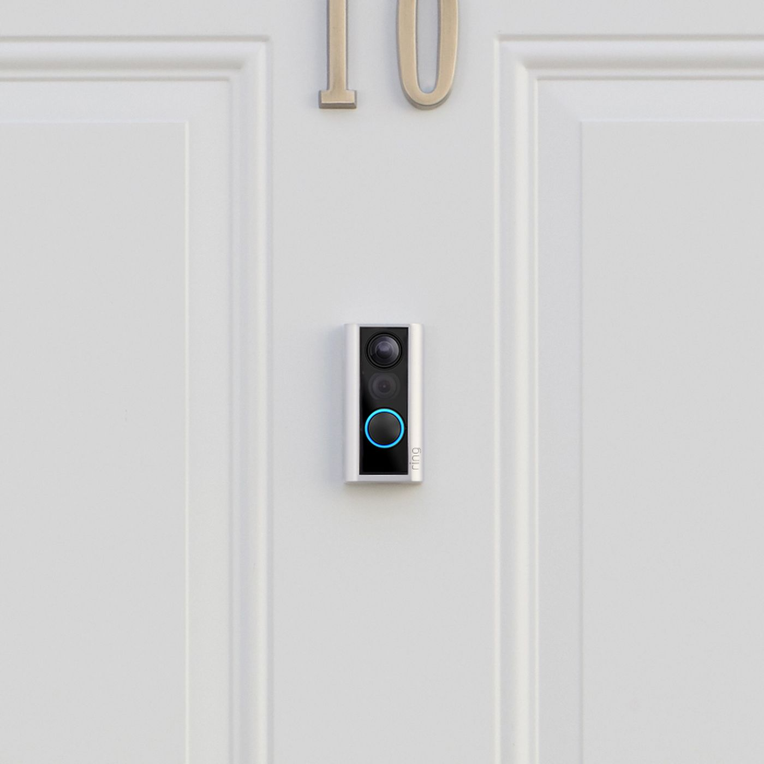
System Implementation
Module Implementation
2. Face Detection
Face detection is a computer technology being used in a variety of applications that identifies human faces in digital images.
A camera (mobile phone/webcam) is placed at the entrance.
This immediately captures a photo when the user clicks on the capture button in the GUI.
this
Approved by AICTE |Affiliated to VTU | Recognized by UGC with 2(f) & 12(B) status |Accredited by NBA and NAAC

Slide 39
System Implementation
GUI for Face Recognition
Approved by AICTE |Affiliated to VTU | Recognized by UGC with 2(f) & 12(B) status |Accredited by NBA and NAAC

Slide 40

System Implementation
What is the action taken?
Registered user?
Unauthorised user?
Welcome user
No access given
Approved by AICTE |Affiliated to VTU | Recognized by UGC with 2(f) & 12(B) status |Accredited by NBA and NAAC

Slide 41

System Implementation
Working of face recognition system
How do humans recognize faces ?
Can you tell who this person is?
Approved by AICTE |Affiliated to VTU | Recognized by UGC with 2(f) & 12(B) status |Accredited by NBA and NAAC

Slide 42
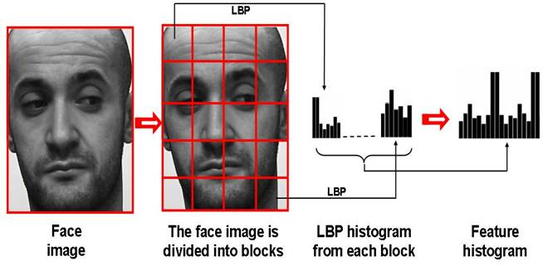
System Implementation
Working of face recognition system
Can a computer do the same?
Taking inspiration from the human visual system, Computer Vision researchers have tried to come up with different features to efficiently describe the uniqueness in each persons face.
Approved by AICTE |Affiliated to VTU | Recognized by UGC with 2(f) & 12(B) status |Accredited by NBA and NAAC

Slide 43
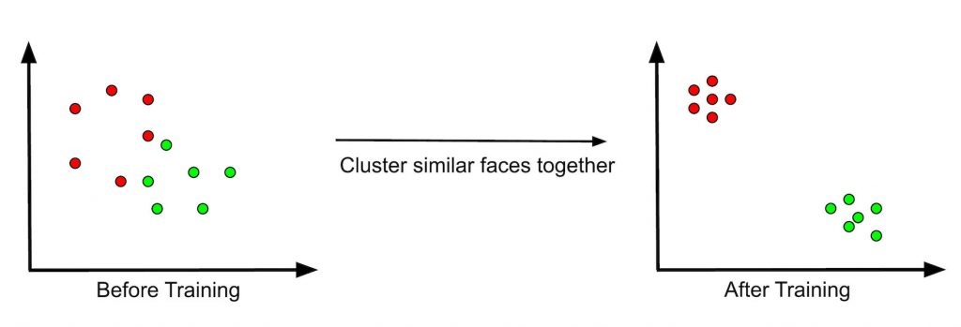
System Implementation
Working of Face recognition.
What happens to the feature Histograms ?
Approved by AICTE |Affiliated to VTU | Recognized by UGC with 2(f) & 12(B) status |Accredited by NBA and NAAC

Slide 44
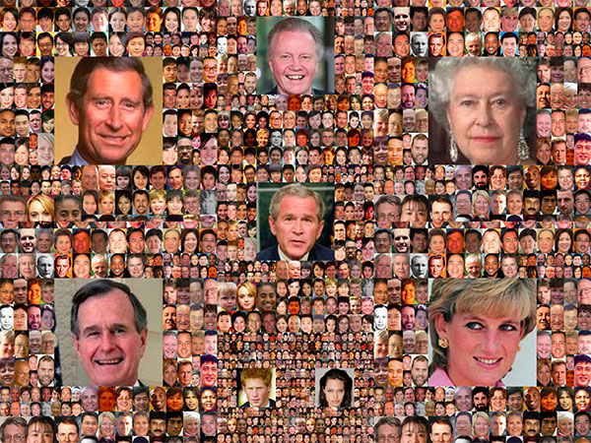
How to obtain obtain higher face recognition accuracy?
MORE DATA

Slide 45
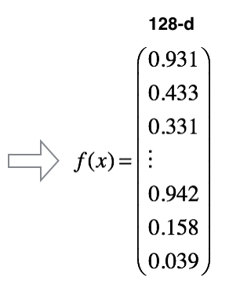
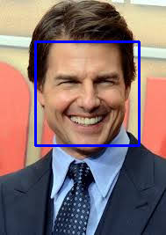
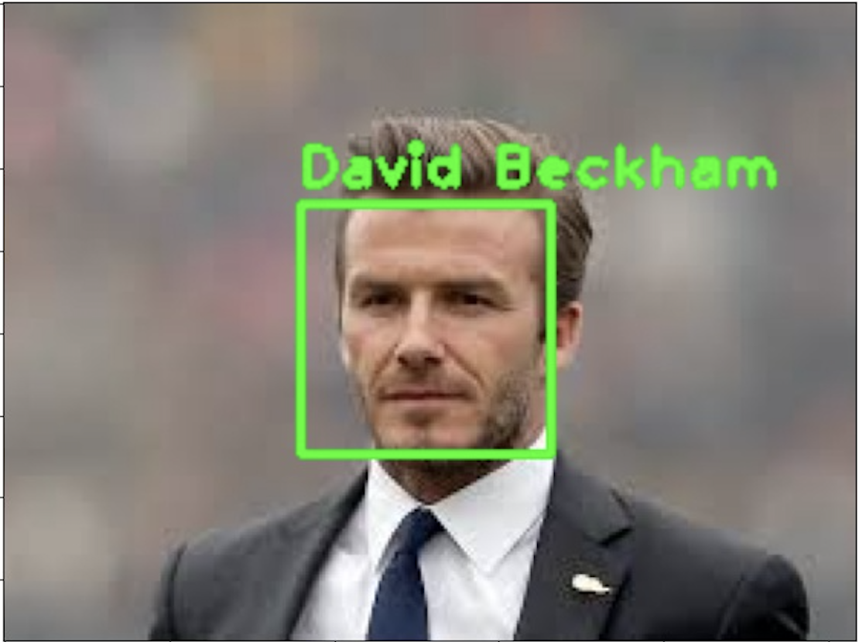
System Implementation
Algorithm Implementation
1.Flow of the Face Recognition Algorithm
Step 1:- Detect faces
Step 2:- Compute 128-d face embedding’s to quantify a face.
Step 3:- Train a support vector machine on top of the embeddings.
Step 4:- Recognize faces in the images captured from the Image.
Step 5:- Store image and compare with these images for future reference.

Slide 46

System Implementation
Module Implementation
3. Intrusion detection Module
An intrusion detection system (IDS) is a device or software application that monitors an area for malicious activity.
Motion sensors are installed around the compound walls of the house.
PIR Sensor
Approved by AICTE |Affiliated to VTU | Recognized by UGC with 2(f) & 12(B) status |Accredited by NBA and NAAC

Slide 47
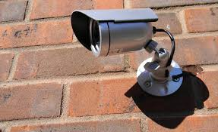
System Implementation
Module Implementation
3. Intrusion detection Module
To prevent unauthorized entry of people, cameras are placed near the compounds. These cameras are activated when motion is detected by the motion sensors, and clicks several photos of the intruder as soon as an alert is sounded
10
Approved by AICTE |Affiliated to VTU | Recognized by UGC with 2(f) & 12(B) status |Accredited by NBA and NAAC

Slide 48
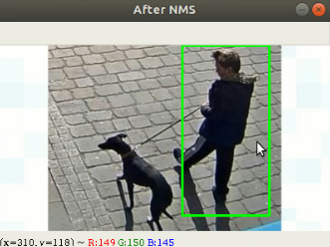
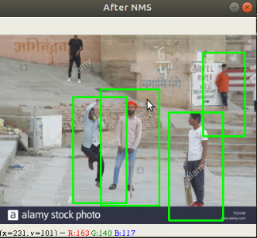
System Implementation
Module Implementation
3. Intrusion detection Module
All the images are stored in a folder and the and folder undergoes extraction of positive and negative images.
The model is trained in such a way as to detect for people in the given photographs.
Approved by AICTE |Affiliated to VTU | Recognized by UGC with 2(f) & 12(B) status |Accredited by NBA and NAAC

Slide 49

System Implementation
Module Implementation
So how to implement the model ??
Histograms of Oriented Gradients for Human Detection proposed by N. Dalal and B. Triggs
inbuilt functionality to provide HOG based detection
It also includes a pre-trained model for Human Detection.
Approved by AICTE |Affiliated to VTU | Recognized by UGC with 2(f) & 12(B) status |Accredited by NBA and NAAC

Slide 50

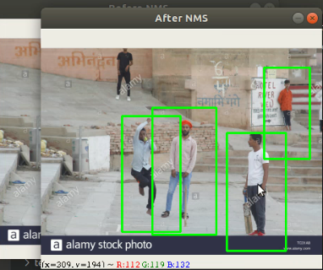
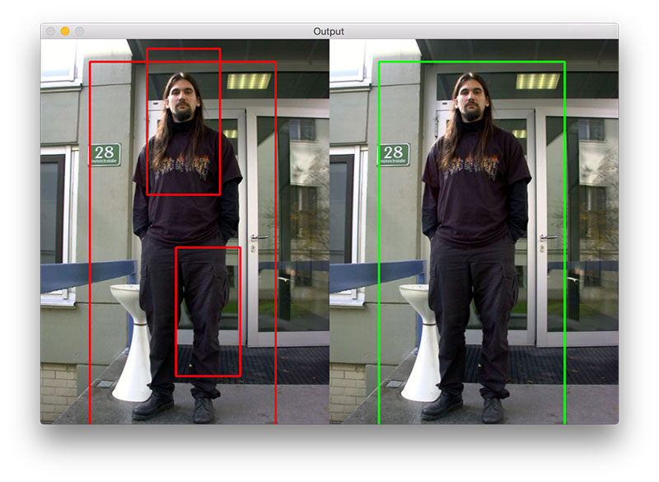
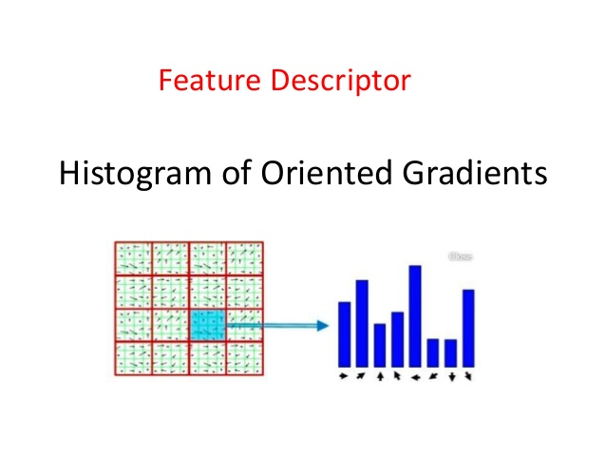
System Implementation
Algorithm Implementation
1.Flow of the Human Detection Algorithm
Step 1:- Hog extraction of positive and negative images.
Step 2:- Feed descriptors in SVM.
Step 3:- Benchmark SVM with static images.
Step 4:- Extract and display humans detected.
Step 5:- Raise an alarm only if humans are detected.

Slide 51
System Implementation
Module Implementation
4. GUI module
Tkinter is a standard module to implement the GUI .Ease of access is our main aim and intention with respect to the development of the GUI module.
But why choose Tkinter out of everything?
Because it’s simple :)
Approved by AICTE |Affiliated to VTU | Recognized by UGC with 2(f) & 12(B) status |Accredited by NBA and NAAC

Slide 52
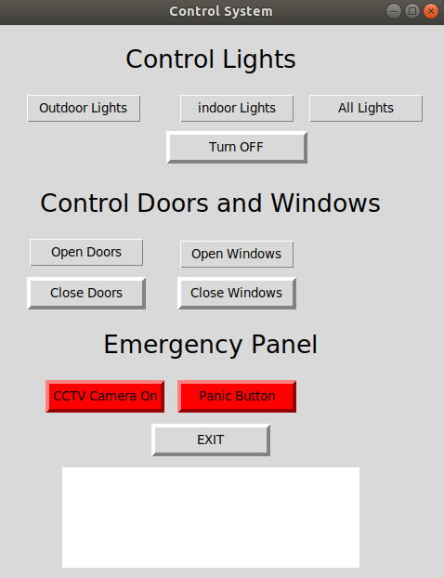
So what does the GUI really offer?
One click access to everything

Slide 53
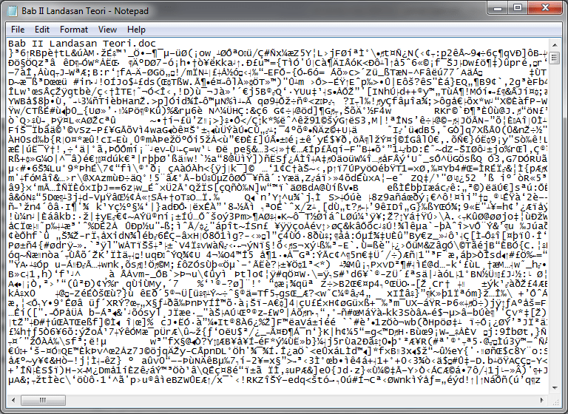

System Implementation
Module Implementation
5. Encryption Module
Encryption is the process of encoding a message or information in such a way that only authorized parties can access it and those who are not authorized cannot.
Real
Encrypted
Approved by AICTE |Affiliated to VTU | Recognized by UGC with 2(f) & 12(B) status |Accredited by NBA and NAAC

Slide 54

System Implementation
Module Implementation
5. How to encrypt?
Module
Package
CRYPTOGRAPHY
FERNET
Fernet guarantees that a message encrypted using it cannot be manipulated or read without the key.
Fernet also has support for implementing key rotation via MultiFernet
Approved by AICTE |Affiliated to VTU | Recognized by UGC with 2(f) & 12(B) status |Accredited by NBA and NAAC

Slide 55
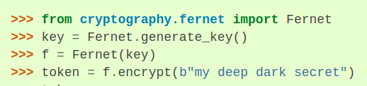

Sample code using Cryptography fernet.
Encrypted File
32 bit Key

Slide 56
System Implementation
Module Implementation
6. Text to Voice Module
Voice recognition is a computer software program or hardware device with the ability to decode the human voice.
Voice recognition is commonly used to operate a device, perform commands, or write without having to use a keyboard, mouse, or press any buttons.
The Python module pyttsx3 was used to implement the voice module.
Module
PYTTSX3
Approved by AICTE |Affiliated to VTU | Recognized by UGC with 2(f) & 12(B) status |Accredited by NBA and NAAC

Slide 57
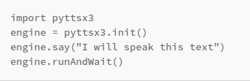
System Implementation
Module Implementation
6. Text to Voice Module
pyttsx3 is a text-to-speech conversion library in Python. Unlike alternative libraries, it works offline.
Sample test code for Voice
Approved by AICTE |Affiliated to VTU | Recognized by UGC with 2(f) & 12(B) status |Accredited by NBA and NAAC

Slide 58
System Testing and Validation
1.Face Detection
TEST CASE ID | TESTCASE | EXPECTED RESULT | ACTUAL RESULT | REMARKS
1 | Face_detection() | Face will either be Recognized or not. | Face is Recognized. | Successful
2 | Train() | Images of Different Faces are fed into the system | Image Module OpenCV Trained. | Successful
Approved by AICTE |Affiliated to VTU | Recognized by UGC with 2(f) & 12(B) status |Accredited by NBA and NAAC

Slide 59
System Testing and Validation
2.Pedestrian Detection
TEST CASE ID | TESTCASE | EXPECTED RESULT | ACTUAL RESULT | REMARKS
1 | Pedestrian_detection() | Human will be Detected. | Humans are Detected. | Successful
2 | Train() | Training Data is fed to System. | Training Data is fed to System | Successful
Approved by AICTE |Affiliated to VTU | Recognized by UGC with 2(f) & 12(B) status |Accredited by NBA and NAAC

Slide 60
System Testing and Validation
3. Fire Detection
TEST CASE ID | TESTCASE | EXPECTED RESULT | ACTUAL RESULT | REMARKS
1 | Detect() | Fire and Smoke are Detected, Doors open Automatically, Exhaust is Turned on. | Fire and Smoke are Detected, Doors open Automatically, Exhaust is Turned on. | Successful
2 | Train() | The Input Image is Processed in HSB Frame. | The Input Image is Processed in HSB Frame. | 80% Successful
Approved by AICTE |Affiliated to VTU | Recognized by UGC with 2(f) & 12(B) status |Accredited by NBA and NAAC

Slide 61

Conclusion and Future Scope
In this project, we investigate the problem of Smart buildings using IOT. Existing solutions are either limited to a specific setting of the problem, or incur expensive, redundant computations. Hence, we propose novel and efficient solutions
Time to go Smart !
Approved by AICTE |Affiliated to VTU | Recognized by UGC with 2(f) & 12(B) status |Accredited by NBA and NAAC

Slide 62
Conclusion and Future Scope
In the future, we plan to develop a much more efficient smart building system, with fewer expenses while continuingly emphasizing on the
Do It Yourself (DIY) trend. We also plan to be more tech savvy and implement more futuristic systems in the future.
Approved by AICTE |Affiliated to VTU | Recognized by UGC with 2(f) & 12(B) status |Accredited by NBA and NAAC

Slide 63
References
Sourav Roy, Md Nasir Uddin, Md Zahirul Haque, Md Jahidul Kabir. Smart Door Lock System with Face Recognition Method. Nanjing University of Posts and Telecommunications, China. In, IJCSN Volume 6 Issue 7, December 2018.
Narasimha Prasad, L V Shankar Murthy P, Kishor Kumar Reddy C. Analysis of Magnitude for Earthquake Detection using Primary Waves and Secondary Waves. In, ICHCI September 2014, IEEE.
AJAYI Olasupo Opeyemi, OLAIFA Oluwaseun. Detecting Intrusion in Large Farm Lands and Plantations in Nigeria Using Virtual Fences. In, University of Lagos, Nigeria, 2016
R. Angeline, Adithya S, Abishek Narayanan. Fire Alarm System Using IOT. In, IJITEE Volume 8 Issue 6S3, April 2019.
Approved by AICTE |Affiliated to VTU | Recognized by UGC with 2(f) & 12(B) status |Accredited by NBA and NAAC

Slide 64
References
https://www.pyimagesearch.com/2015/11/09/pedestrian-detection-opencv/
https://www.pyimagesearch.com/2018/09/24/opencv-face-recognition/
https://medium.com/@madhawavidanapathirana/https-medium-com-madhawavidanapathirana-real-time-human-detection-in-computer-vision-part-1-2acb851f4e55
https://www.learnopencv.com/face-recognition-an-introduction-for-beginners/
https://monkeylearn.com/blog/introduction-to-support-vector-machines-svm/
https://towardsdatascience.com/non-maximum-suppression-nms-93ce178e177c
Approved by AICTE |Affiliated to VTU | Recognized by UGC with 2(f) & 12(B) status |Accredited by NBA and NAAC

Slide 65
Paper Publication Details
Published In - International Journal of Research and Analytical Reviews (IJRAR)
UGC & ISSN Approved. E-ISSN 2348-1269, P-ISSN 2349-5138.
Paper Title - Smartect Security and Automation Using IoT & Image Processing
Authors - Kumar R, Deepak Jangir, H S Rakshak, Krishan Jangir, Yezdan R
Paper ID - IJRAR 2002557
Published Issue - Volume 7 | Issue 3 | August 2020
Impact Factor: 5.75
Approved by AICTE |Affiliated to VTU | Recognized by UGC with 2(f) & 12(B) status |Accredited by NBA and NAAC

